Slide 1
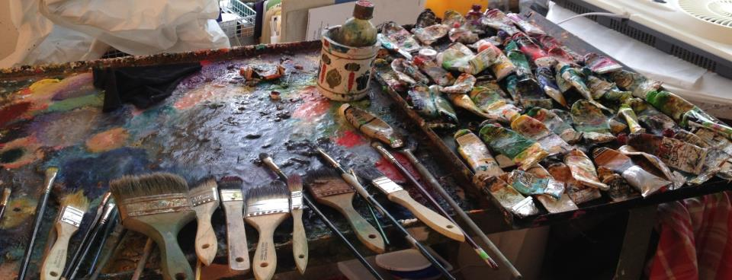
Chemical Hazards in Arts
Dave Waddell
Art Hazards Project Manager
waddellenviro@yahoo.com
206-679-7984

Slide 2
One tequila Two tequila Three tequila

Slide 3
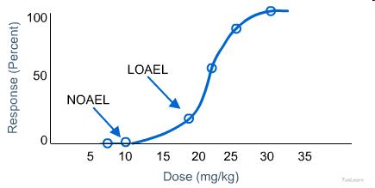
Dose and response
Small dose, big impact
Adverse effects compared to “normal”

Slide 4
Effects of size on response
Photo © Michelle Riggen-Ransom – Attribution licensed at www.flickr.com/photos/riggenransom/4868969263/

Slide 5
We’re constantly chemically exposed
Flame retardants
Bisphenol A
Phthalates
Diesel exhaust
Wood smoke
Fragrances
Food additives
Source: Center for Disease Control
King County photo by Sue Hamilton
Notes:
Chemicals like this are found in:
Furniture
Plastics
Cookware
Food
5

Slide 6
Our bodies can handle a lot, given the chance
Avoid those exposures you can…
Photo © Greg Westfall. Used within rights expressed at www.flickr.com/photos/imagesbywestfall/3890281501/
Notes:
The good news (I bet you were waiting for some!) is that are bodies are resilient to many toxicants, if we give them the chance.

Slide 7
Routes of exposure
Inhalation is easiest route of exposure Acids, dusts and solvents
Swallow It
Breathe It
Touch It
Inject It
Photos by Petr Kratochvil- Public domain
Photo by Linda James -Public domain

Slide 8
Understanding solvents
Solvents evaporate
Dissolve and deliver/remove materials
Evaporation rate = volatility
VOC = volatile organic compound

Slide 9
Solvents can be flammable or toxic
Lacquer thinner’s the most hazardous

Slide 10
Turpentine is more toxic, more volatile and more flammable than mineral spirits
Gamsol is pure with no toxic aromatic solvents When evaporated there’s no residue

Slide 11
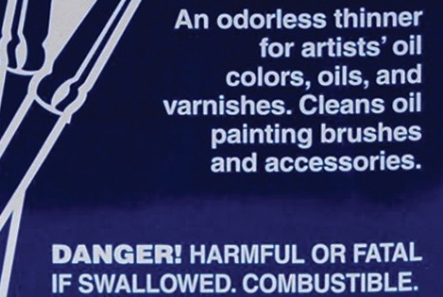
Safer isn’t the same as safe

Slide 12
Allergen Skin Sensitizer Combustible

Slide 13
Corrosive compounds in the arts
Photochemistry
Intaglio printmaking
Glass etching
Patination of metals
Pickling of metals

Slide 14
Hazardous liquids require splash goggles
Jackson Safety V-80 Monogoggle
Photo © Perfecto insecto. Used within rights expressed at http://www.flickr.com/photos/perfectoinsecto/2835340516/

Slide 15
Eye washes required near corrosives
0.4 gallons a minute for 15 minutes
Hands-free
Tepid water
Available from Grainger and others for under $100
King County photo by Dave Waddell
Public domain:
www.acclaimimages.com/_gallery/_print_pages/0420-1007-3011-5328.html

Slide 16
Photographic stop baths
Acetic acid vapors
Sodium sulfite contamination from developer
Acids in intaglio printmaking
Ferric chloride
Burns skin and eyes on contact
Hydrochloric acid
Vapors burn skin, eyes, lungs
Nitric acid - Bad news
Photo ©Hunter-Desportes. Used within rights expressed at http://www.flickr.com/photos/hdport/3814969792/

Slide 17
Nitric Acid Toxicity
Nitric acid for zinc plates Corrosive, oxidizer, toxic
Highly toxic orally
Fuming nitric acid – red color
Inhalation of vapors
Intense irritation
Feel better for awhile
Then depressed lung function, coma, death

Slide 18
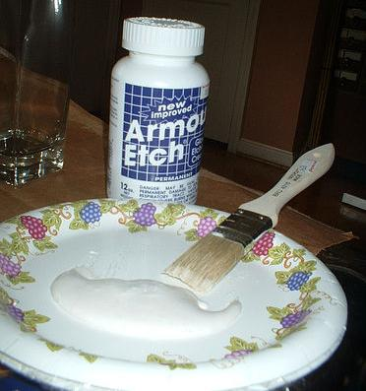
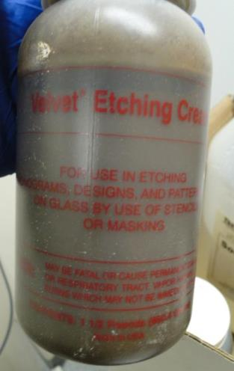
Glass etching compounds
Photo: © Styro Cait. Used within rights expressed at
www.flickr.com/photos/styro/22411852/
Photo: ©Dave Waddell – Used with permission

Slide 19
Hydrofluoric acid (HF) Absorbs quickly through skin
Anesthetic
Bone disintegration
Extreme pain
Gangrene, amputation
250 mls = death
Used as toilet stain remover
Mix Armour Etch with water You get hydrofluoric acid
©American Society for Surgery of the Hand
www.eatonhand.com/complic/figures/hfl.htm

Slide 20
Patinas Many recipes to choose from
Liver of sulfur
Releases poisonous sulfide gas when acidified
Requires good local ventilation
Keep off skin
King County photos by Dave Waddell

Slide 21
Applying acid patina
Hydrochloric acid
Phosphoric acid
Selenious acid
Nitric acid

Slide 22
Black patina - selenious acid
Corrosive
Very poisonous
Absorbs directly through skin
Easily inhaled vapors can cause pulmonary edema/coma

Slide 23
Toxic metals
Many pigments contain ground metals
Some of these are quite toxic
Inhalation is usually the route of concern

Slide 24
Antimony
Inhalation can harm lungs, heart, enzymes
Ingestion can cause kidney damage, respiratory failure
Skin contact can cause ulcers
Naples yellow 41
Antimony white 11

Slide 25
Arsenic
Corrosive to skin
Damages nervous system, kidneys, mucous membranes
Skin, bone marrow, lung cancer
English, Paris, Veronese, Schweinfurt greens
Cobalt violet
Emerald green
Green 21, 22
Scheele’s green
Yellow 39
Photo © http://janeaustensworld.files.wordpress.com/2010/03/450px-paris_green.jpg

Slide 26
Cadmium
Poison by inhalation, ingestion
Internal organ damage
Lung and prostrate cancer
Cadmium red
Cadmium orange
Cadmium yellow
Red 108, 113
Orange 20, 23
Yellow 37

Slide 27
Chromium
Lung damage
Skin and respiratory irritant
Carcinogen
Barium chromate
Lead chromate
Strontium chromate
Zinc chromate
Chromic oxide
Chromic sulfate
Image © www.naturalpigments.com/chrome-yellow-medium.html

Slide 28
Cobalt
Inhalation linked to asthma, fibrosis
Ingestion linked to heart damage
Animal carcinogen
Dryer in inks
Cobalt blue
Cobalt violet
Aureolin
Cobalt yellow
Cerulean blue

Slide 29
Lead
Toxic by inhalation, ingestion
Nervous system damage
Reproductive toxin
Children are more at risk
Flake white
Lead white
Naples yellow
Chrome yellow
White #2, 4
Red #103, 104, 105
Orange 21, 45
Yellow 34, 46
Green 15

Slide 30
Manganese
Irritant to eyes, lungs
Chronic inhalation causes nervous system disorder that resembles Parkinson’s disease
Dryer in inks
Raw/burnt umber
Manganese blue, violet
Red 48
Blue 33
Violet 16
Black 14, 26

Slide 31
Mercury
Toxic by inhalation, skin contact, ingestion
Nervous system damage
Vermillion
Cinnabar
Mercadium colors
Red #106
Image ©Margret Short www.margretshort.com. Used with permission http://margretshort.typepad.com/an_artist_and_her_work_ma/2006/12/index.html

Slide 32
Nickel
Skin allergies/eczema
Pulmonary edema
Carcinogen by inhalation
Nickel yellow
Nickel titanate
Titanium yellow
Rutile yellow
Yellow 53, 57, 150
Green 10

Slide 33
Labels are helpful!
King County photo by Dave Waddell
Notes:
The label on a container is good place to start your detective work on whether a product is toxic. Look for words like Caution, Warning, Danger or Poison, then read the information immediately following the warning.

Slide 34
1988 Labeling of Hazardous Art Materials Act
Requires manufacturers to list potentially harmful substances in paint products
“Trade secrets” lets some withhold potentially important information from the customer
For instance, if there’s under one percent formaldehyde, it may not be listed on the label

Slide 35
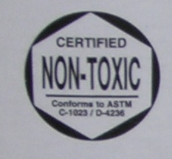
Potentially safer products
AP or CP Sticker (approved)
Evaluated by a toxicologist
Not considered toxic
Fewer acute or chronic risks
Look for word “Non-Toxic”
Photos: Dave Waddell

Slide 36
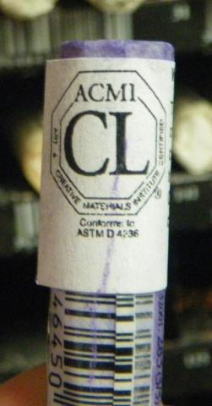
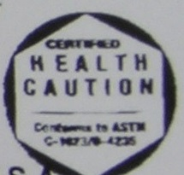
Caution label
Evaluated for health risks
Info on safe & proper use
Common constituents:
Toxic metals like lead & cadmium
Photos: Dave Waddell
Notes:
If AP and non-toxic indicates the safer alternative art products, what symbol tells us the product contains hazardous ingredients? The ACMI’s CL label is their Caution Label, indicating the product contains a toxic ingredient, like the cobalt in the pastel stick on the left.
The label on the bottom left is interesting, it contains both the AP non-toxic symbol and the Health Label (which represents hazardous). Who thought Health Label was a good choice as a warning???
This label is from a container holding liquid manganese glaze. Manganese is not particularly toxic by ingestion, but if sufficient dust or fumes of manganese are inhaled, it can cause symptoms that are very similar to Parkinson’s Disease.

Slide 37
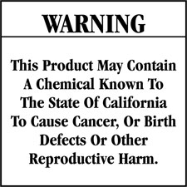
Avoid products with this warning

Slide 38
Label your secondary containers Name and main hazard
Limitations on labels
Risks evaluated for 25 year old, 180 lb man
Not all hazards are chemical-based
Sensitivities and susceptibilities vary
Your knowledge is only as good as the label
Notes:
The name on a secondary container should match the one on the label of the original product container. Add a word or two that describes the main hazard. FLAMMABLE or TOXIC.

Slide 39
Note the happy face
Beware of greenwashing!

Slide 40
Back of aerosol can
“1,1,1-Trichloroethane is an Class 1 Ozone Depleting Substance under Section 602 of the Clean Air Act.”

Slide 41
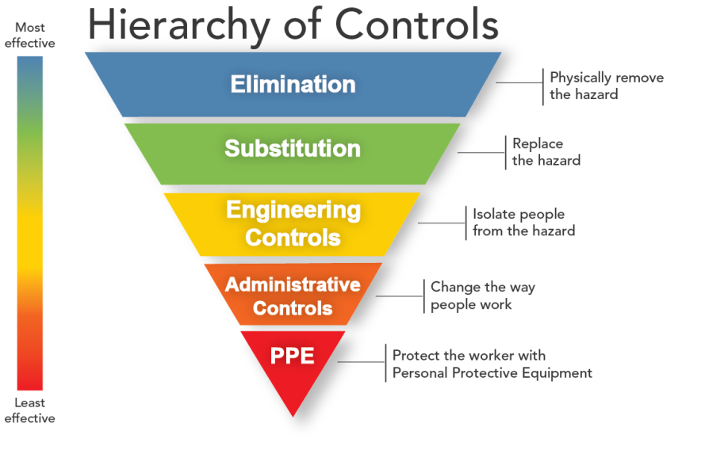
Protecting artist’s health and safety

Slide 42
MORE EFFECTIVE
Not using toxic stuff
Using less HAZARDOUS stuff
Sucking toxic vapors/dusts away
Barriers between toxic stuff and you
LESS EFFECTIVE
Notes:
If we want to avoid harmful exposures, what are our options. Here’s the hierarchy of protection.
Want to avoid lead poisoning?, don’t use lead or other toxic metals.
If you must use metals, use one that is less toxic
If the materials you need are toxic, then try to carry away any contaminants they create like dusts or vapors.
If that’s not a possibility, then put a barrier between you and the harmful product.

Slide 43
How much is getting on your piece? How much is entering your lungs?

Slide 44
Spray adhesive solvents All are flammable, toxicity varies
Higher toxicity ↑
Toluene
Hexane
Cyclohexane
Acetone
Heptane
Petroleum naphtha
Methylpentane
Lower toxicity ↓
Which should we choose?
Used with permission from http://www.parmodels.com/

Slide 45
Let’s look at those cans
Avoid hexane + acetone combo!
Powerful neurotoxin if inhaled or on skin
Destroys nerve cells in extremities (hands/feet)
Poor recovery from damaged nerves

Slide 46
Spray Adhesive Precautions
Check the ingredients
Avoid hexane & toluene
Avoid breathing vapors
Outside upwind
Use a spray booth
Use protective gloves
Never with young kids
Hexane in rubber cement Heptane – safer substitute
© http://telltaleheartstudio.com Used with permission

Slide 47
Toxic heavy metals
Encaustic pigments
Avoid inhalation or contaminated clothing
Avoid heavy-metal based pigments
No issues with solid wax
Water, oil & wax bind pigments

Slide 48
Let’s look at ceramics
Clay dusts contain free silica
Silicosis from inhaling silica over time
Work with wet clay to limit dust
The clay on those pants won’t stay wet
Photo © Ewan Traveler. Used within rights expressed at www.flickr.com/photos/ewan_traveler/2633864586/

Slide 49
Not the ways to clean up clay dust
Vacuuming? Use HEPA filters

Slide 50
Wet mop instead
Control dust contamination Use moist microfiber mops & cloths for final pass
Kiln emissions
Photo © Robert S. Donavan. www.flickr.com/photos/booleansplit/2979169728/

Slide 51
Comparative toxicity Volatility increases availability
Metal | Permissible exposure limit (mg/M³) | Melting/boiling pt. °F
Arsenic | 0.005 | 1502 / 1135
Cadmium | 0.005 | 610 / 1409
Silver | 0.01 | 1763 / 4013
Lead | 0.05 | 621 / 3164
Cobalt | 0.1 | 2723 / 5198
Selenium | 0.2 | 423 / 1265
Barium | 0.5 | 1337 / 2084
Chromium | 1.0 | 3375 / 4842
Copper | 1.0 | 1981 / 4653
Nickel | 1.0 | 2647 / 4950
Manganese | 5.0 | 2273 / 3564

Slide 52
Low fire clay bisque: 1321–1458°F
Cadmium, lead and barium melt
Arsenic and selenium boil
Low fire: 1750–2110°F
Lead and silver melt
Arsenic, cadmium, barium and selenium boil
Mid and high range: 2124–2381°F
Lead, manganese and silver melt
Arsenic, cadmium, barium and selenium boil
Photo ©knitgirl63. Attribution licensed at www.flickr.com/photos/knitgirl63/3963563278/

Slide 53
Protecting yourself from inhalation toxins
Select an N95 dust mask or respirator
Best methods Half-mask cartridge respirator Local exhaust ducts
Best methods Half-mask cartridge respirator Local exhaust ducts
Photo © Maria aka riaskiff. Used within rights expressed at http://www.flickr.com/photos/riaskiff/2311123619/

Slide 54
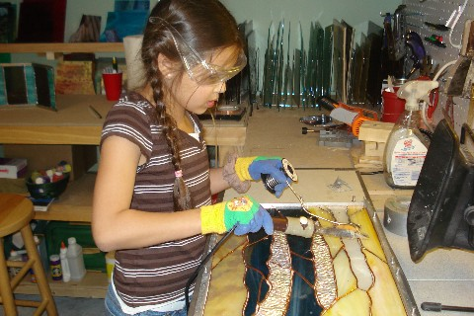
Local ventilation for toxic dusts/vapors
you art work
Clean air comes in
toxics
sucked
away
© Used with permission
http://www.lin-mdesignsinglass.com/gpage.html

Slide 55
What about indoor air cleaners?
Particles?
High efficiency (HEPA) filter
Chemical vapors or fumes?
HEPA then charcoal filter
Change filters when needed
Balance cost/performance

Slide 56
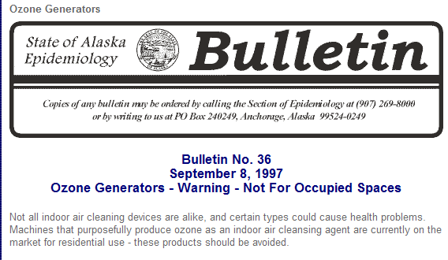
Avoid ozone generators!

Slide 57
Homemade local exhaust option
Local exhaust can be inexpensive
Inexpensive but must still work properly. Target flow rate is 100 linear feet/minute
Avoid crimps in ventilation ducts
Photo © Jaime Rojo. http://www.brooklynstreetart.com/theblog/2011/11/03/street-artist-xam-architecture-for-the-city-bird/
Notes:
Many artists have created their own local exhaust systems. Here’s one that was posted on the internet.
Though it pulls air and solvent vapors outside; it must be checked to see if it is adequate for the process.
Filters can clog and fans can stop working. The fan may not be pulling sufficient air to remove all the pollutants.

Slide 58
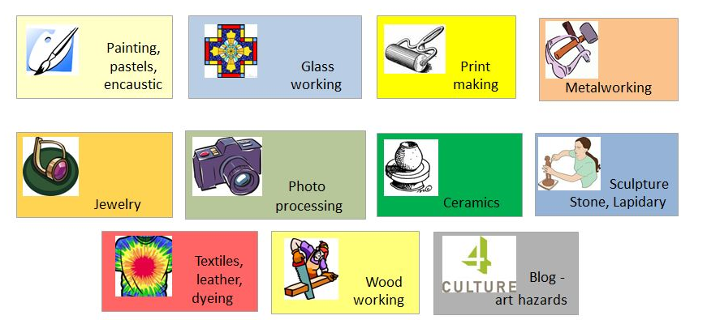
Some discipline-specific guidelines

Slide 59
OK, let’s talk photochemistry
Common photography issues
Exposure to toxic developers
Lack of chemical eyewash near corrosives
Improper disposal of waste fixer
Photo ©istolethetv. Attribution licensed at http://www.flickr.com/photos/istolethetv/3385751903/

Slide 60
Amidol
Highly toxic by inhalation - asthmagen
Severe irritation and allergies to skin
Absorbed through skin to blood stream
Catechin (catechol)
Poison by inhalation
Convulsions, damages liver & kidneys
Severe skin irritation and allergies
Absorbed through skin
Ingestion of one gram can be fatal
Photo ©Nesster. Used within rights expressed at http://www.flickr.com/photos/nesster/5375201698/

Slide 61
Hydroquinone
Irritation and allergies from skin contact
Toxic by ingestion
Eye injuries

Slide 62
p-Phenylenediamine
Highly toxic by all routes of exposure
Severe skin allergies
Inhalation can cause severe asthma
Ingestion linked to nervous system damage

Slide 63
Reducing risks from developers
Use premixed chemicals to avoid dusts
Adequate ventilation (10-20 air changes/hour)
Protect your skin
Photo ©Tom Hart. Used within rights expressed at http://www.flickr.com/photos/thart2009/6161126958/

Slide 64
Ceramics
Toxic metal exposure risks
Glaze mixing
Firing
Sanding
Sweeping
Leaching
Photo © Peter Stevens aka nordique: http://www.flickr.com/photos/nordique/7348924478/

Slide 65
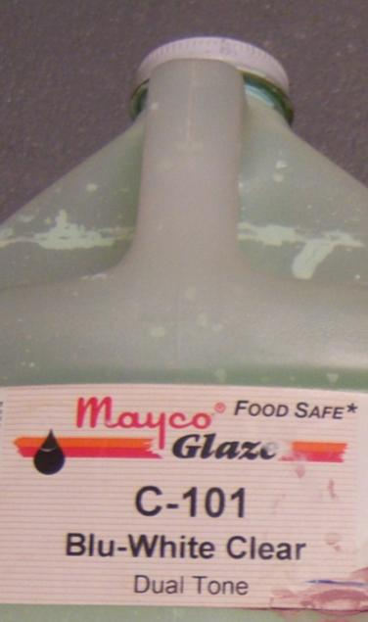
Glazes
Buy premixed to avoid dust
This one says “Food Safe∗”
Photo: Dave Waddell

Slide 66
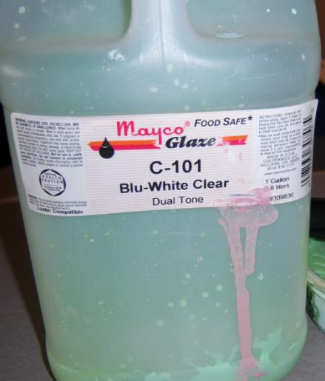
Wait a minute
What’s that symbol?
Read the labels carefully
Photo: Dave Waddell

Slide 67
Jewelry
Soldering and brazing hazards
Smoke is dust
Ultrafine particles
Deeply inhaled
Readily enter bloodstream
Photo © Joe Diels– https://flic.kr/p/6TBtXy

Slide 68
Hazardous metals of concern
Lead
Neurotoxin
Cadmium
Carcinogen by inhalation
Nickel
Carcinogen by inhalation, skin sensitizer

Slide 69
Toxins linked to soldering/brazing
Some metal fumes released
Lead, cadmium, silver, nickel
Not a problem if good ventilation is provided
Fluoride-based flux
Toxic
Bone and teeth defects
Photo © www.mountainmade.com
Used with permission

Slide 70
Use a fluoride-free, borax flux
Safer pickle options?
Citric acid
Acetic acid (vinegar) and salt
King County photos by Dave Waddell

Slide 71
Make your pickle last!
Avoid contamination!
Just add a bit of water to replace evaporation
Acid puts copper in solution
It’s not OK to pour it down the drain
Most artists neutralize before disposal
Neutralizing doesn’t remove copper which is extremely toxic to fish
Photo © Derek Gavey. Used within rights expressed at www.flickr.com/photos/derekgavey/5990702434/

Slide 72
Painting & Drawing
Aqua Oils
Mix of vegetable oil, detergent, metallic soap drier and pigment
Oil drier Combustible, toxic, sensitizer
Prevent rag fires

Slide 73
Linseed oil
Low toxicity
Causes spontaneous rag fires
Safer oil-paint brush cleaners
Photo: Dave Waddell

Slide 74
Safer substitutes - Printmaking
Plates that don’t require a nitric acid etch
Gamsol-like odorless thinners
Disposable screens for screen printing
Water-based film-adhering fluids

Slide 75
Safer substitutes - Glassworking
Cullet instead of powdered glass
Wet grinding and cutting
Bead blasting instead of acid etching

Slide 76
What is waste?
What is hazardous?
Corrosive
Toxic
Flammable
Reactive
Don’t want it
Can’t use it
Unknown
Orphaned
Spilled
King County photo by Dave Waddell

Slide 77
What’s not hazardous waste?
Something that’s still useful
Empty containers
Things that are hazardous but not chemicals
Public domain: http://www.innocentenglish.com/funny-pics/lolcats/ninja-cat-pic.jpg

Slide 78
Handle wastes properly
Securely store them
Separate these incompatibles
Acids in separate cabinet
Flammables in separate cabinet
Bleach away from ammonia

Slide 79
Reduce your waste generation – And your disposal costs!
Buy only what you need
Use it all up
Select non-hazardous products
See if others can use viable art products you no longer need

